Slide 1
Normal Cryogenic Fluid Behavior (emphasis on helium, but not superfluid, which will be covered later)
Tom Peterson, SLAC
January 2017

Slide 2
Outline
Cooling modes for superconducting devices
Forced flow cooling
Two-phase flow and pool boiling
Fluid dynamics
Saturated bath thermodynamics

Slide 3
Large-scale cooling of superconducting devices
Physicists and engineers designing a large-scale liquid helium system typically must design the cooled components (magnets or RF cavities, their containers, and the interfaces to them)
Cooling mode, heat transfer, pressure drops, cool-down, warm-up and non-steady or upset system operations all must be considered as part of the component design
The cooled devices must be viewed as part of the cryogenic system

Slide 4
Cooling modes in large-scale cryogenic systems recently in operation
Pool boiling helium I used in superconducting RF for HERA (DESY), LEP (CERN), KEKB (KEK, Japan), CESR (Cornell)
Forced flow of subcooled or supercritical helium I for cooling superconducting magnets (Tevatron, HERA, SSC, RHIC, ITER)
Stagnant, pressurized helium II (the Tore Supra tokamak in France demonstrated the technology, LHC magnets)
Saturated helium II (CEBAF, TTF at DESY, SNS at Oak Ridge, and others, foreseen for FRIB, Project X, ILC, and more)
This list also illustrates the extent to which superconductivity and cryogenics have become standard technology for accelerators

Slide 5
Helium phase diagram (S. W. VanSciver, Helium Cryogenics, p. 54)
Critical point
5.2 K, 2.245 atm
Lambda transition at 1 atm
2.172 K
SRF -- HERA, LEP, KEKB, CESR
Magnets -- HERA, Tevatron
Magnets -- SSC
Magnets -- Tore Supra, LHC
SRF -- CEBAF, TTF, SNS, ILC

Slide 6
Cooling modes -- magnets vs RF
Accelerator magnets are often cooled with subcooled liquid
Typically working near the limit of the superconductor with large stored energy
Ensure complete liquid coverage and penetration
Superconducting RF cavities are generally cooled with a saturated bath
Large surface heat transfer in pool boiling for local “hot spots”
Very stable pressures, avoid impact of pressure variation on cavity tune

Slide 7
Cooling modes--surface heat flux
Boiling helium I (normal helium)
1 W/cm² in nucleate boiling with 0.5 K temperature rise to the object surface so equivalent to 2 W/cm²K
Forced convection helium I
Convection coefficients on the order of 0.1 W/cm²K
Saturated helium II (superfluid helium, SF)
1 W/cm² heat transport to the surface without bubbles
Pressurized helium II
Kapitza conductance about 0.6 W/cm²K

Slide 8
Pressurized versus pool boiling
Pressurized helium (normal or superfluid) gives maximum penetration of helium mass in magnet coils, which may be a factor in stability if not also heat transfer. But heat flow results in a temperature rise.
Pool boiling gives pressure stability (important for superconducting RF), provides maximum local heat transfer, and provides nearly isothermal cooling.

Slide 9
Heat transport through channels--pressurized normal helium in SSC
SSC dipole nominal operating temperature was to be 4.35 K, tightly constrained for magnet quench performance
Allowable temperature rise of only 0.050 K allowed heat absorption of about 4 J/gK x 0.050 K = 0.20 J/g and forced high flow rate (100 g/s) as well as use of recoolers
Forced flow of supercritical helium periodically recooled by heat exchange with a saturated bath

Slide 10
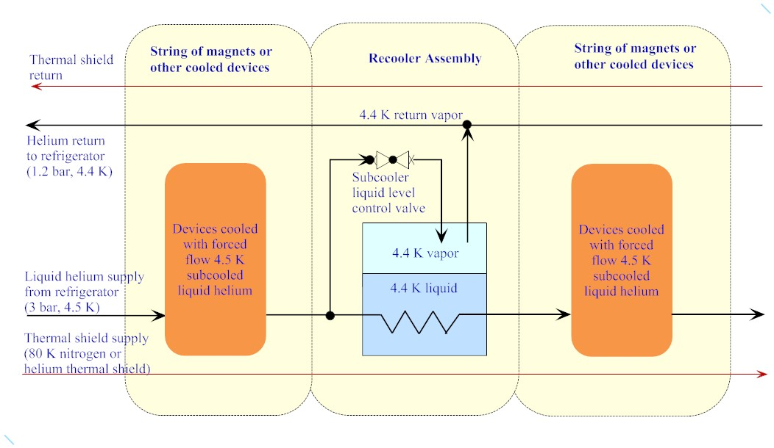
Recooler flow scheme

Slide 11
Heat transport through channels--pressurized normal helium
This plot of helium enthalpy versus T illustrates the large amount of heat absorbed (20+ J/g) if one can tolerate 6.5 K or even more
Nominally “5 K” thermal intercept flow may take advantage of this heat capacity
H(J/g)
40
30
20
10
5
6
7
T (K)

Slide 12
Convective heat transfer
Convective heat transfer – heat transfer from a solid surface into a moving fluid
A complex sequence of heat transfer from the surface to a boundary layer and into the bulk fluid, a combination of conduction and mass transport
We analyze convection with the equation

Slide 13
Evaluating h_{c}
This equation defines the convection coefficient, h_{c}
Empirical and semi-empirical methods are used to find approximate h_{c}
Formulations for liquids and gases work reasonably well for normal helium
Several dimensionless parameters are commonly used

Slide 14
Reynolds number, Re
Re provides a ratio of fluid inertia to viscosity
Re < 2000 in a tube is generally laminar flow

Slide 15
Nusselt number, Nu
Correlations of Nu with other parameters have proven useful in evaluation of convection coefficients

Slide 16
Prandtl number, Pr
Prandtl number is a ratio of fluid properties
Relates velocity profile (kinematic viscosity is a sort of momentum diffusivity) to the temperature profile (thermal diffusivity) from the surface into the fluid

Slide 17
Correlations
For gases (0.6 < Pr < 0.8, for example Pr for helium gas = 0.66) in a long pipe with fully developed velocity profile

Slide 18
Convection summary
Far too large a topic to cover here
Many correlations, depending on whether free convection, laminar, or turbulent, fluid properties, etc.
Entrance effects, surface and boundary layer effects
Nevertheless, the classical correlations generally work well for normal helium

Slide 19
More about 2-phase helium flow
“Baker plot” published in 1954 based on data for air and water and applied to oil and gas in pipes
In 1960 - 1961, work at Los Alamos suggested the diagram could be applied to 2-phase hydrogen
Papers published in 1985 and 1987 at the CEC described experimental results showing that the Baker plot does not apply to 2-phase helium flow
For practical pressure drops and flow velocities with normal helium, one may assume that 2-phase helium flow is separated
CEA Grenoble studies of 1.9 K 2-phase flow for CERN found that a vapor flow of about 5 m/sec begins to entrain liquid droplets

Slide 20
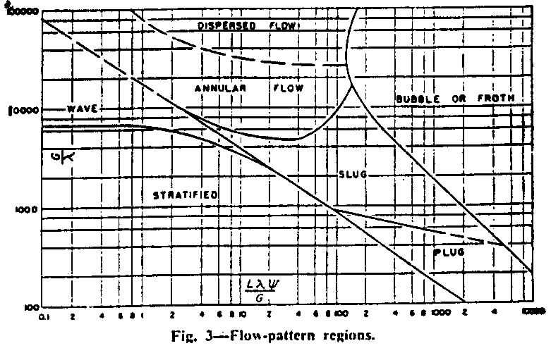
Plot from “Simultaneous Flow of Oil and Gas,” by Ovid Baker (1954) -- Do not use for helium!

Slide 21
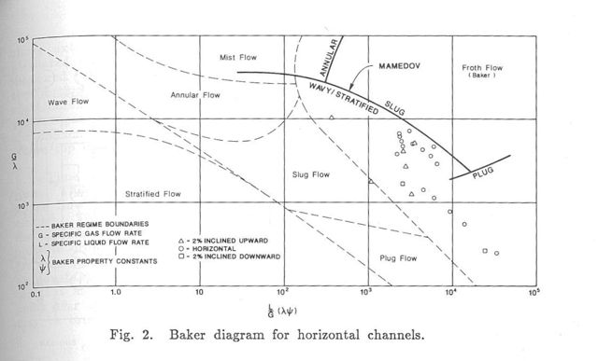
Do not use Baker Plot for helium
J. C. Theilacker and C. H. Rode,
An Investigation into Flow Regimes
for Two-phase Helium Flow, Advances
In Cryogenic Engineering, Vol. 33,
pp. 391-398, 1988.

Slide 22
Pool boiling and 2-phase flow
Considerations for pool boiling systems
Control of liquid levels, long time constants, inventory management
Forced convection for warm-up and cool-down
Two-phase flow
Liquid and vapor phases separate with any acceptably low pressure drop
Baker Plot does not apply!

Slide 23
Boiling Heat Transfer for Oxygen, Nitrogen, Hydrogen, and Helium,
by E.G. Brentari, et al, NBS Technical Note 317, Boulder, CO, 1965.

Slide 24
Helium boiling curves
Note the transition from nucleate to film boiling at about 1 K delta-T
Working delta-T for nucleate boiling such as in a helium subcooler (pressurized helium cooled by boiling helium) is ~0.1 K.

Slide 25
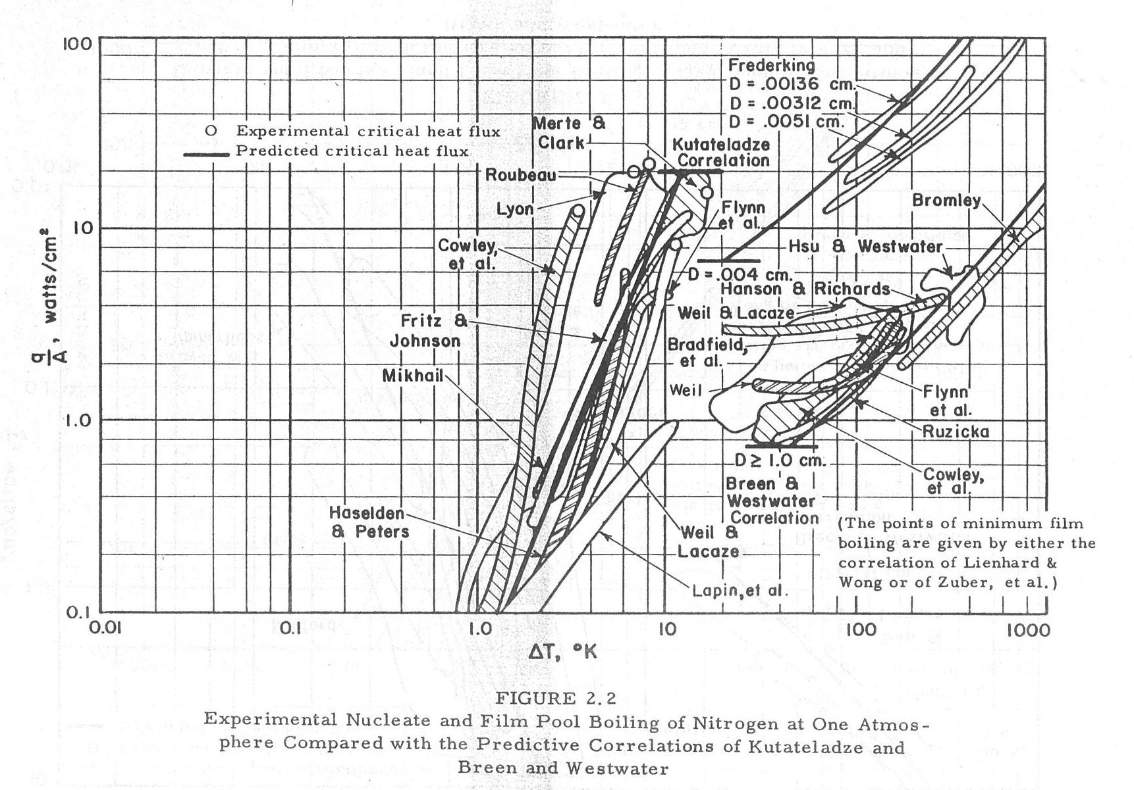
More boiling curves
Boiling Heat Transfer for Oxygen, Nitrogen, Hydrogen, and Helium,
by E.G. Brentari, et al, NBS Technical Note 317, Boulder, CO, 1965.

Slide 26
Some simple analytic formulas for fluid flow
In designing cryogenic piping, we generally have low pressure drop and may assume steady-state conditions for normal operational conditions
Emergency venting may be very dynamic, non-steady, but we often do conservative analyses assuming worst-case as if a steady-state condition
Cryogenic liquids and vapors (except for Helium II) behave like normal liquids and gases
Standard engineering pressure drop and heat transport equations may be used

Slide 29
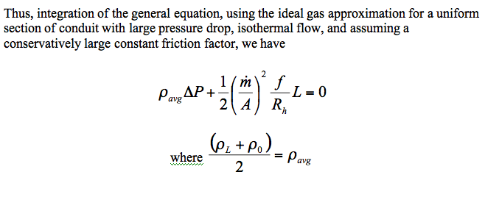
The point of this little derivation is to show that for sections of pipe
with large enough pressure drop that density and velocity changes
are significant, iterating pressure drop calculations to come up with
a linear average density through the section of constant cross section
gives a good estimate of pressure drop.

Slide 30
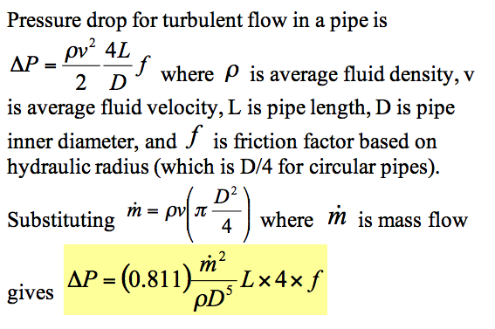
Pressure drop analysis, working formula for round pipes This is a form of the D'Arcy-Weisbach formula. With pressure drop expressed as head loss, this is sometimes called simply the Darcy formula. (Note that delta-P changed signs here, to a positive number.)

Slide 31
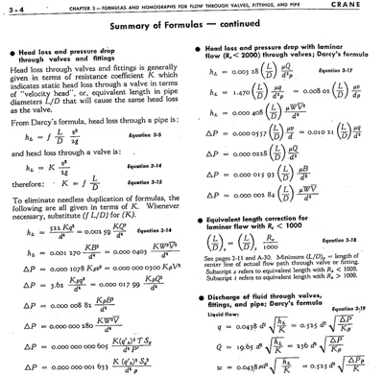
Crane Technical Paper #410 “Flow of Fluids through Valves, Fittings, and Pipes”

Slide 32
For example from previous list
Where ΔP is pressure drop in psi, V is the specific volume (in³/lbm), K is the total resistance coefficient = fL/d so is dimensionless, W is the mass flow rate (lbm/hr), and d is the pipe inner diameter (in).
Compare to
from slide 34 -- no unit conversions, and a different definition of friction factor. Note! Some sources define f based on hydraulic radius and some on diameter, a factor 4 difference for pipes!

Slide 33
Example pressure drop analyses
See Excel file C5_39_relief_calcs-TJP.xls
Illustrates relief venting calculation with stepwise reassessment of Re, friction factor, and fittings losses for constant mass flow
See Excel file PressureDropLongPipeDec2008.xls
Pipe divided into sections for reassessment of properties

Slide 34
Heat capacity discussion
The following plots illustrate the fact that the heat capacity of metals becomes vanishingly small at liquid helium temperatures
Cool-down to ~80 K is dominated by removal of heat from the solid materials
Cool-down below ~20 K is dominated by removal of heat from the helium

Slide 35
Heat capacity

Slide 37
Provisions for cool-down and warm-up
Cool-down
Return vapor may block liquid supply flow in the same channel; a simple fill from the top or one end might not work. A cool-down vent and/or a bottom-fill port may be required.
Warm-up
Flow will stratify. Local electric heat, a bottom vent port, or other feature to force heat down to the lower parts of a cold mass may be required.
The small “capillary” tubes connected to a manifold and providing helium to the bottoms of helium vessels in TESLA-style cryomodules were included primarily with warm-up in mind

Slide 38
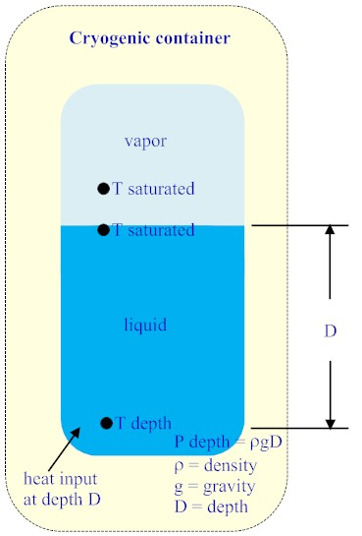
Subcooling in a liquid bath
Saturated liquid (in equilibrium
with vapor at its surface) has a
higher pressure below the surface
by virtue of the weight of the liquid.
This pressure provides the
possibility for a slightly elevated
temperature below the surface
without boiling and/or some
subcooling below the vapor
pressure at that higher pressure.
The pressure under a head of
liquid is

Slide 39
Pressure head of helium column
Thus, for helium at 4.5 K,
Now, it would be good to understand the relationship of this elevated pressure below the surface to a new saturation temperature at that pressure. This new temperature, higher than the saturation temperature at
the surface, tells us how much delta-T is available for heat transfer without the onset of boiling.

Slide 40
Clapeyron Equation

Slide 41
Basis for Clapeyron Equation
The Clapeyron Equation comes from two substances in equilibrium over a phase transition satisfying ΔG=0
Where G = Gibbs free energy is defined as
G = H – TS

Slide 42
Delta-T available under a head of liquid helium at 4.5 K
Note that 10.8 mK/meter, although a small number, implies a significant saturation temperature increase at, for example, 10 meters depth, for example down to an accelerator tunnel or experimental hall.

Slide 43
Delta-T available under a head of liquid helium at 2.0 K
Note that 0.14 mbar/cm or 14 mbar/meter is a significant
delta-P relative to the total pressure of 30 mbar at 2.0 K.

Slide 44
Saturated bath of liquid Argon
Pure liquid argon is a common component of high energy physics detectors
Liquid argon calorimetry
Time Projection Chamber (TPC)
In both cases, especially in the latter, purity and lack of bubbles are important for minimal noise and good signal
TPC depends on electron drift to a charged plate, and electron lifetime is critical

Slide 45
Looking at maximum
heat flux via free
convection (no boiling)
for D0 liquid argon
calorimeter back in
1988.
Analytical process:
Calculate available ΔT
as a function of depth.
Given ΔT, calculate
free convective heat
flux for various
geometries and
Orientations.

Slide 46
Liquid Argon TPC
Heat input from supports and other heat sources to the liquid argon bath should not produce bubbles
Heat transport by free convection without nucleation of bubbles
Free convection driven by liquid density differences, due to temperature differences
Temperature differences limited by saturation temperature at depth

Slide 47
Total pressure vs vapor pressure
Consider a glass of water open to normal air and at the same temperature as the air
100% humidity in air ➔ water vapor in air in equilibrium with liquid in the glass
Now warm the water slightly ➔ saturation pressure of liquid higher than vapor pressure of water in air
Why does it not boil?
Answer: bubbles must overcome total pressure, not just vapor pressure of the water in air
Typically our cryogenic systems involve pure helium and nitrogen, so vapor pressure = total P

Slide 48
Inhibit boiling with total pressure
One could accomplish the same sort of thing for a liquid argon bath
Pressurize the system with helium gas
Total pressure much higher than vapor pressure of LAr
(Problem for detectors: argon purity with some helium dissolving in LAr)

Slide 49
References
S. W. VanSciver, “Helium Cryogenics,” Plenum Press, 1986.
R. Byron Bird, Warren E. Stewart, Edwin N. Lightfoot, “Transport Phenomena,” John Wiley &Sons, 1960.
Ovid Baker, "Design of Pipelines for the Simultaneous Flow of Oil and Gas," Oil and Gas Journal (July 26, 1954) p. 185-195
J. C. Theilacker and C. H. Rode, “An Investigation into Flow Regimes for Two-phase Helium Flow,” Advances in Cryogenic Engineering, Vol. 33, pp. 391-398, 1988.
E.G. Brentari, et al, “Boiling Heat Transfer for Oxygen, Nitrogen, Hydrogen, and Helium,” NBS Technical Note 317, Boulder, CO, 1965.
Crane Technical Paper #410 “Flow of Fluids through Valves, Fittings, and Pipes”

